Slide 1
Methods for Solving Recurrences
Iteration method
Recursion-tree method
Master method
16

Slide 2
Recurrences and Running Time
Recurrences arise when an algorithm contains recursive calls to itself
Running time is represented by an equation or inequality that describes a function in terms of its value on smaller inputs.
T(n) = T(n-1) + n
What is the actual running time of the algorithm? i.e. T(n) = ?
Need to solve the recurrence
Find an explicit formula of the expression
Bound the recurrence by an expression that involves n

Slide 3
Example Recurrences
T(n) = T(n-1) + n
Recursive algorithm that loops through the input to eliminate one item
T(n) = T(n/2) + c
Recursive algorithm that halves the input in one step
T(n) = T(n/2) + n
Recursive algorithm that halves the input but must examine every item in the input
T(n) = 2T(n/2) + 1
Recursive algorithm that splits the input into 2 halves and does a
constant amount of other work
Θ(n²)
Θ(lgn)
Θ(n)
Θ(n)

Slide 4




BINARY-SEARCH
Finds if x is in the sorted array A[lo…hi]
Alg.: BINARY-SEARCH (A, lo, hi, x)
if (lo > hi)
return FALSE mid ← ⎣(lo+hi)/2⎦
if x = A[mid]
return TRUE
if ( x < A[mid] )
1
2
3
4
5
6
7
8
2 | 3 | 5 | 7 | 9 | 10 | 11 | 12
mid
lo
hi
BINARY-SEARCH (A, lo, mid-1, x)
if ( x > A[mid] )
BINARY-SEARCH (A, mid+1, hi, x)

Slide 5


Example 1
A[8] = {1, 2, 3, 4, 5, 7, 9, 11}
lo = 1 hi = 8 x = 7
1
2
3
4
5
6
7
8
1 | 2 | 3 | 4 | 5 | 7 | 9 | 11
mid = 4, lo = 5, hi = 8
5
6
7
8
1 | 2 | 3 | 4 | 5 | 7 | 9 | 11
mid = 6, A[mid] = x
Found!

Slide 6

Example 1I
A[8] = {1, 2, 3, 4, 5, 7, 9, 11}
lo = 1 hi = 8 x = 6
1
2
3
4
5
6
7
8
1 | 2 | 3 | 4 | 5 | 7 | 9 | 11
lo = 1, hi = 8, mid = 4. A[4]=4
low
high
1 | 2 | 3 | 4 | 5 | 7 | 9 | 11
lo = 5, hi = 8, mid = 6, A[6]=7
low
high
1 | 2 | 3 | 4 | 5 | 7 | 9 | 11
lo = 5, hi = 5, mid = 5, A[5]=5
1 | 2 | 3 | 4 | 5 | 7 | 9 | 11
lo = 6, hi = 5 ➔ NOT FOUND!
high
low

Slide 7
Analysis of BINARY-SEARCH
Alg.: BINARY-SEARCH (A, lo, hi, x)
if (lo > hi)
return FALSE
mid ← ⎣(lo+hi)/2⎦
if x = A[mid] return TRUE
if ( x < A[mid] )
BINARY-SEARCH (A, lo, mid-1, x)
if ( x > A[mid] )
BINARY-SEARCH (A, mid+1, hi, x)
constant time: c₁ constant time: c₂
constant time: c₃
same problem of size n/2
same problem of size n/2
T(n) = c + T(n/2)

Slide 8
Methods for Solving Recurrences
Iteration method
Recursion-tree method
Master method
8

Slide 9
Several Examples : Iterative Substitution
T(n) = 1 + T(n-1)
T(n) = 1 + (1+T(n-2))
T(n) = 2 + T(n-2)
T(n) = 3 + T(n-3)
T(n) = 4 + T(n-4)
…..
T(n) = k + T(n-k)
For k = (n-1)
T(n) = n – 1 + T(1)
T(n) = n
i.e. T(n) = Theta(n)
Example 1:

Slide 10
Several Examples : Iterative Substitution
T(n) = n + T(n-1)
T(n) = n + (n-1+T(n-2))
T(n) = 2n – 1 + T(n-2)
T(n) = 2n -1 + ((n-2) + T(n-3))
T(n) = 3n -3 + T(n-3)
T(n) = 3n -3 + n-3 + T(n-4))
T(n) = 4n – 6 + T(n-4)
…..
T(n) = kn – c + T(n-k)
For k = (n-1)
T(n) = n^2 -1 – c + T(1)
i.e. T(n) = Theta(n^2)
Example 2:

Slide 11
Several Examples : Iterative Substitution
T(n) = 1 + T(n/2)
T(n) = 1 + (1+T(n/4))
T(n) = 2 + T(n/4)
T(n) = 3 + T(n/8)
T(n) = 3 + T(n/2^3)
…..
T(n) = k + T(n/2^k)
For k = logn => n = 2^k
T(n) = logn + T(1)
T(n) = 1 + log(n)
i.e. T(n) = Theta(logn)
Example 3:

Slide 12
Several Examples : Iterative Substitution
SOLVE THESE PROBLEMS YOURSELF :
1) T(n) = n + 2T(n/2)
2) T(n) = 2T(n-1)
3) T(n) = n + T(n/2)

Slide 13
The Iteration Method
Convert the recurrence into a summation and solve it using a known series
Example:
T(n) = c + T(n/2)
T(n) = c + T(n/2)
= c + c + T(n/4)
= c + c + c + T(n/8)
= c + c + c + c + T(n/2⁴)
Assume n=2^{k} then k = lg n and
T(n) = c + c + c + c + c + … + T(n/2^{k})
(k times)
k * c
T(n) =
T(n) = clg n
+ T(1)

Slide 14
Iteration Method – Example 2
T(n) = n + 2T(n/2) Assume
T(n) = n + 2T(n/2)
= n + 2(n/2 + 2T(n/4))
= n + n + 4T(n/4)
= n + n + 4(n/4 + 2T(n/8))
= n + n + n + 8T(n/8)
T(n) = 3n + 2³T(n/2³)
= kn + 2^{k}T(n/2^{k})
= nlgn + nT(1)
T(n) = O(nlgn)
n=2^{k}
➔ k = lg n

Slide 15
Methods for Solving Recurrences
Iteration method
Recursion-tree method
Master method
11

Slide 16
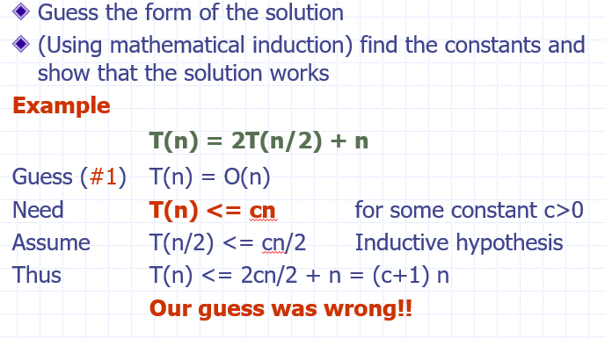
Substitution by Guess and Test Method: Solving Recurrence

Slide 17
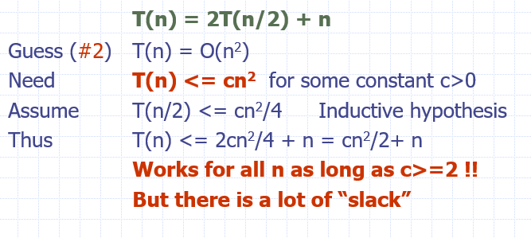
Substitution by Guess and Test Method: Solving Recurrence

Slide 18
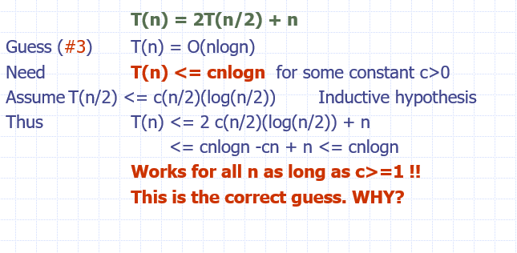
Substitution by Guess and Test Method: Solving Recurrence

Slide 19
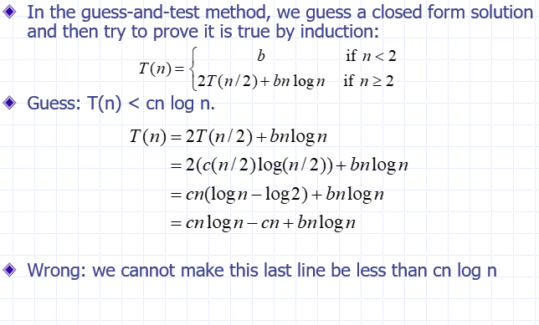
Substitution by Guess and Test Method: Solving Recurrence

Slide 20
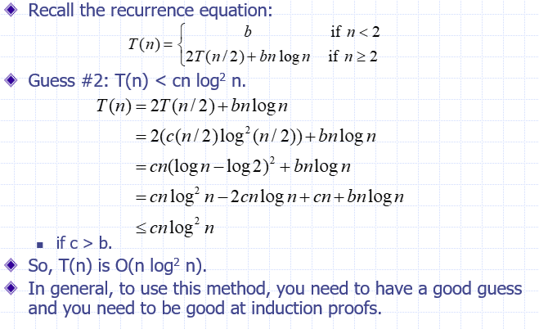
Substitution by Guess and Test Method: Solving Recurrence

Slide 21


The recursion-tree method
Convert the recurrence into a tree:
Each node represents the cost incurred at various levels of recursion
Sum up the costs of all levels
Used to “guess” a solution for the recurrence

Slide 22
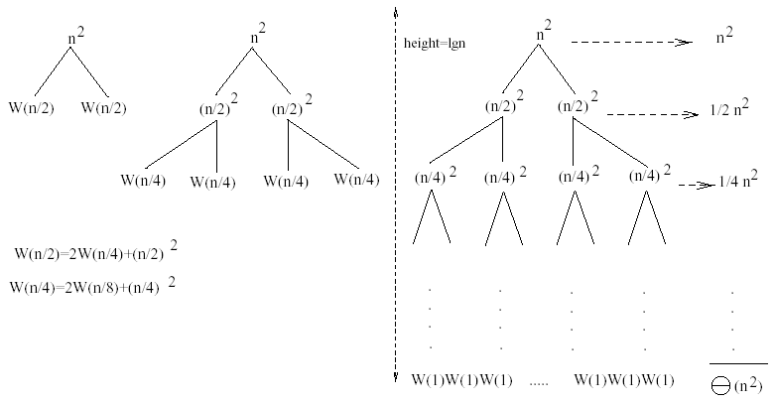

Example 1
W(n) = 2W(n/2) + n²
Subproblem size at level i = n/2^{i}
At level i: Cost of each node = (n/2^{i})² # of nodes = 2^{i}
h = Height of the tree ➔ n/2^{h}=1 ➔ h = lgn
Total cost at all levels:
Total cost = (n²/2^{i})
lg n _{n}2 lg n _{⎛ 1 ⎞}^{i}
∞
⎛ 1 ⎞^{i}
1
W (n) = ∑ = n² ∑⎜ ⎟ ≤ n² ∑⎜ ⎟ =n² = 2n²
i=0 ^{2i} i=0 ⎝ ² ⎠
i=0 ⎝ ² ⎠
1− ¹
2
➔ W(n) = O(n²)

Slide 23

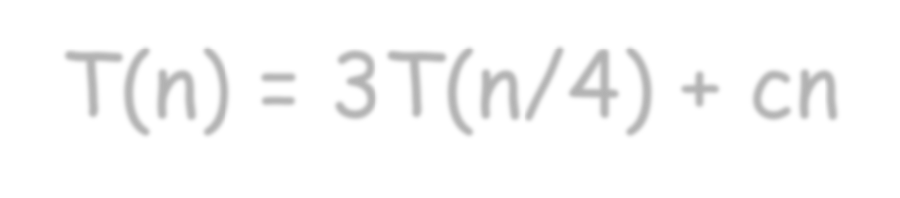


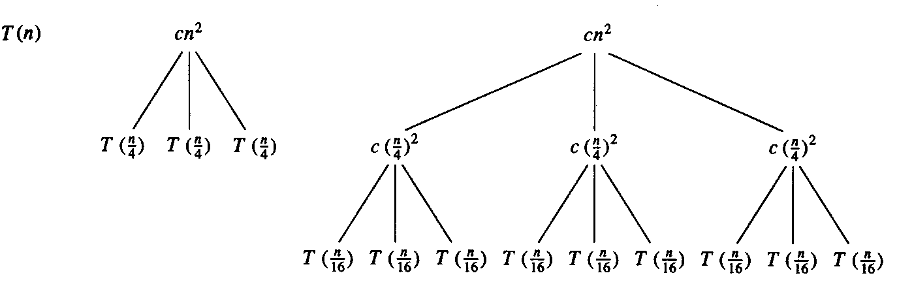

Example 2
T(n) = 3T(n/4) + cn²
Subproblem size at level i = n/4^{i}
At level i: Cost of each node= c(n/4^{i})² # of nodes= 3^{i}
h = Height of the tree ➔ n/4^{h}=1 ➔ h = log₄n
Total cost =cn²(3/16)^{i}
Total cost at all levels: (last level has 3^{log}₄^{n} = n^{log}₄³ nodes)
log₄ n−1 _{⎛ 3 ⎞}^{i}
log₄ 3 ₎ log₄ 3 ₎
log₄ 3 ₎
cn + Θ(n ≤
⎛ 3 ⎞^{i}
1
∑
i=0
∞
( = cn + Θ(n
3
T (n) =
2
∑
2
2
2
⎜ ⎟
⎜ ⎟
cn + Θ n
= O(n )
16
16
⎝ ⎠
i=0 ⎝
⎠
1−
16
➔ T(n) = O(n²)

Slide 24

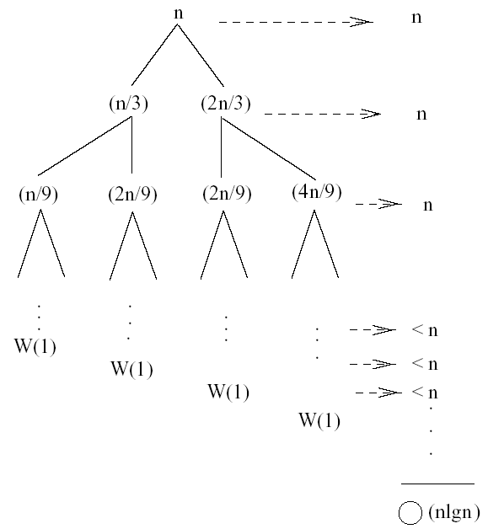
Example 3
W(n) = W(n/3) + W(2n/3) + n
The longest path from the root to a leaf:
n → (2/3)n → (2/3)² n → … → 1
(2/3)^{i}n =1 ⇔ i = log_{3/2}n
Cost of the problem at level i = n
Total cost:
lg n
W (n) = n(log n) = n
= O(n lg n)
3/ 2
lg(3 / 2)
via further analysis ➔W(n) =Θ(nlgn)
15

Slide 25
Substitution by Guess and Test Method: Solving Recurrence

Slide 26
Substitution by Guess and Test Method: Solving Recurrence

Slide 27
Substitution by Guess and Test Method: Solving Recurrence

Slide 28
Substitution by Guess and Test Method: Solving Recurrence

Slide 29
Substitution by Guess and Test Method: Solving Recurrence

Slide 30

CS302 Design and Analysis of Algorithms (Master Theorem )

Slide 31
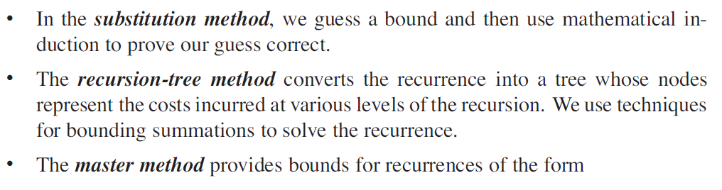

Solving Recurrences
There are three methods for solving recurrences—that is, for obtaining asymptotic bounds on the solution :

Slide 32
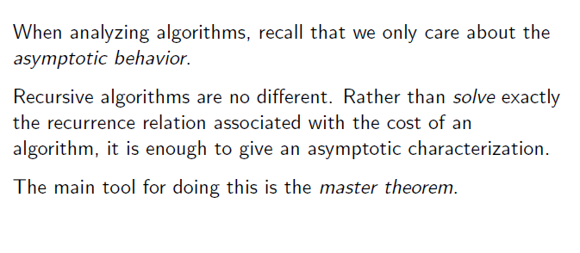
Master Method : Solving Recurrences

Slide 33
Master Method : Solving Recurrences
The above T(n) expression characterizes divide and conquer algorithm that creates “a” sub-problems, each of which is “1/b” the size of the original problem.
To use the master method, you will need to memorize three cases, but once you do that, you will easily be able to determine asymptotic bounds for many simple recurrences.

Slide 34
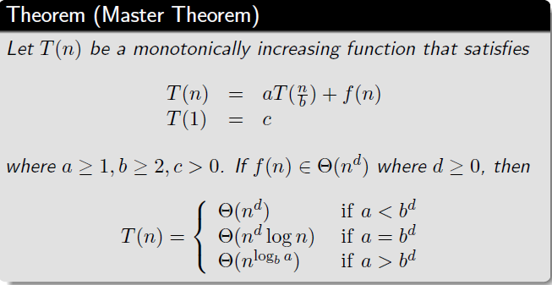
Master Method : Solving Recurrences
Masters Theorem

Slide 35
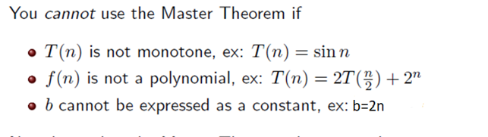
Master Method : Solving Recurrences
Limitations:

Slide 36
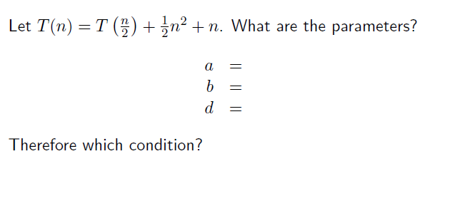
Master Method : Solving Recurrences
Example 1:

Slide 37
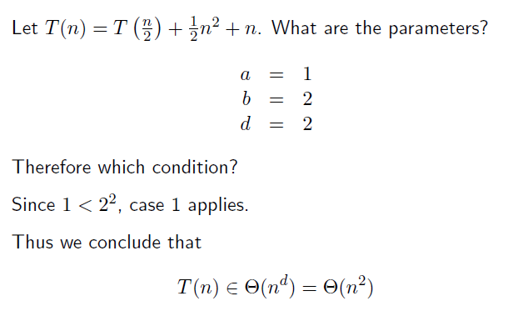
Master Method : Solving Recurrences
Example 1: Solution

Slide 38
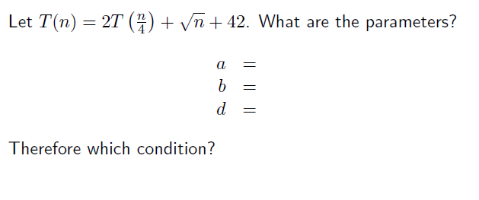
Master Method : Solving Recurrences
Example 2:

Slide 39
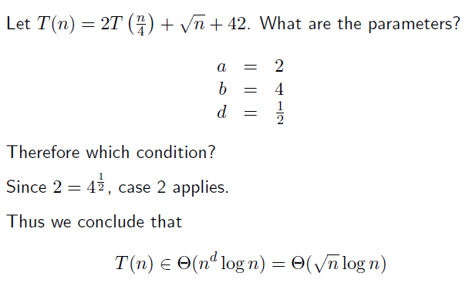
Master Method : Solving Recurrences
Example 2: Solution

Slide 40
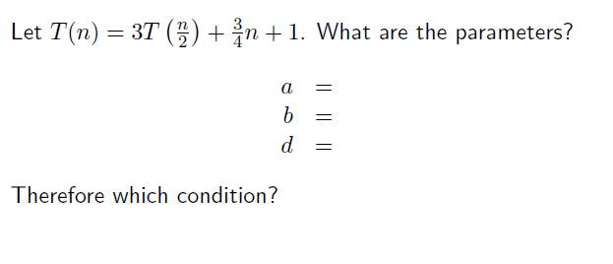
Master Method : Solving Recurrences
Example 3:

Slide 41
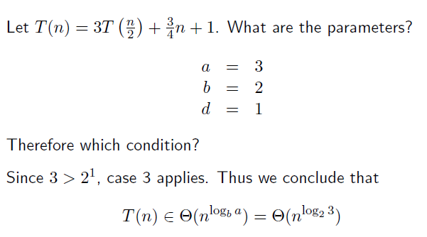
Master Method : Solving Recurrences
Example 3: Solution

Slide 42
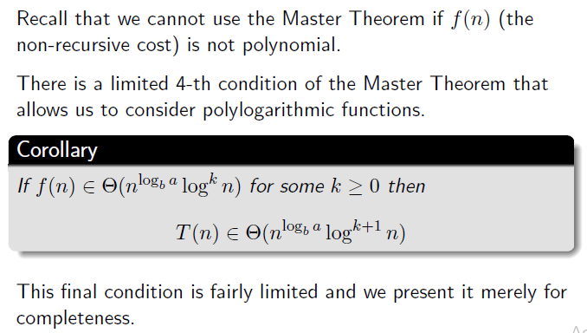
Master Method : Solving Recurrences
Fourth Condition:

Slide 43
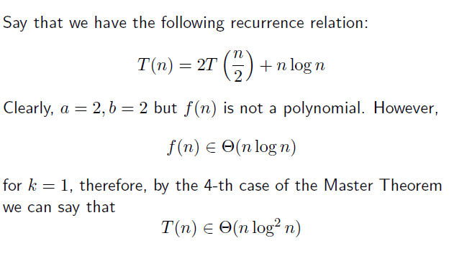
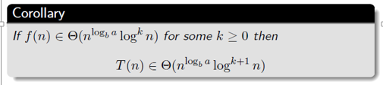
Master Method : Solving Recurrences

